Slide 1

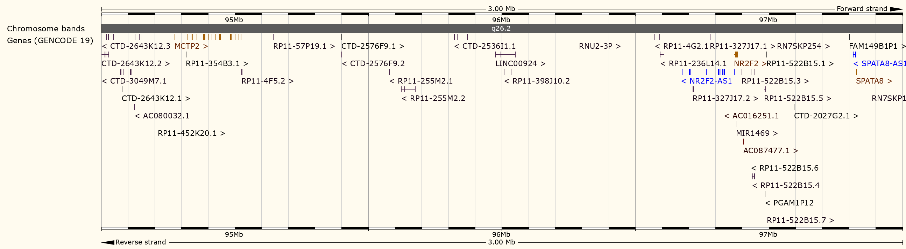
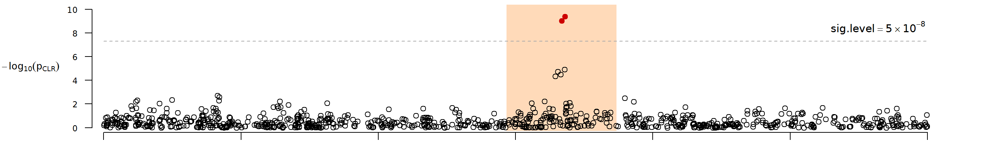
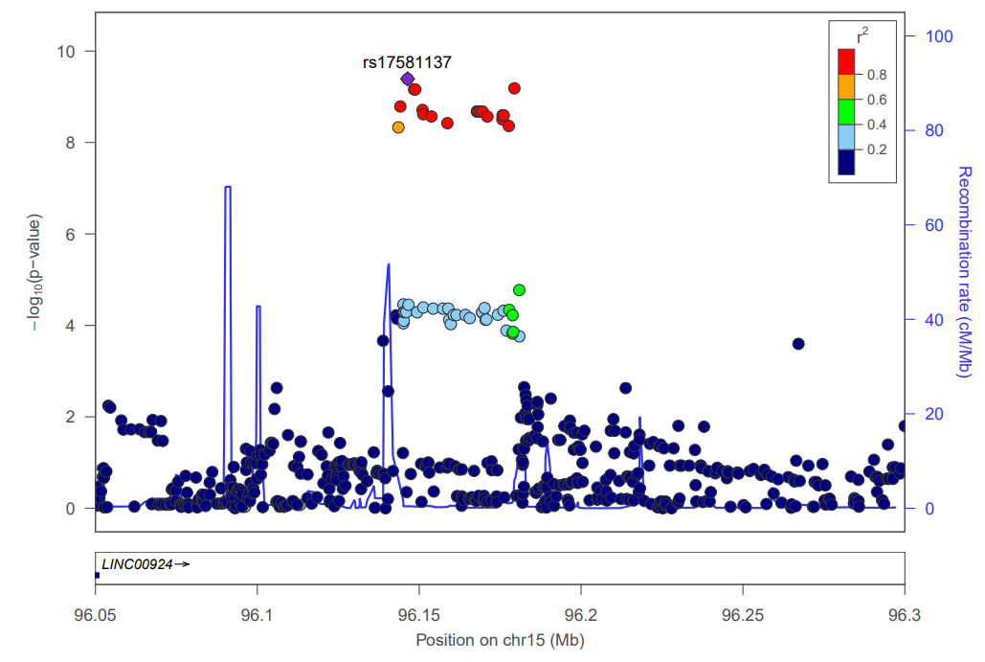
Chromosome 15
Genotyped + Imputed SNPs

Slide 2
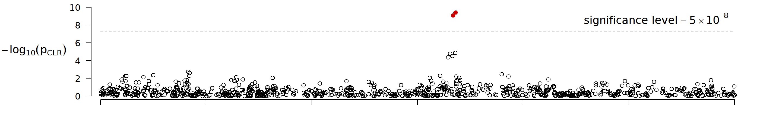
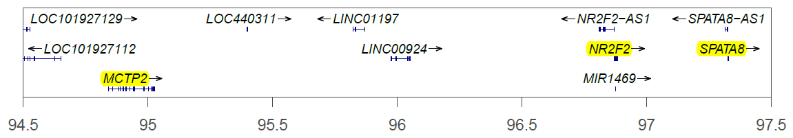
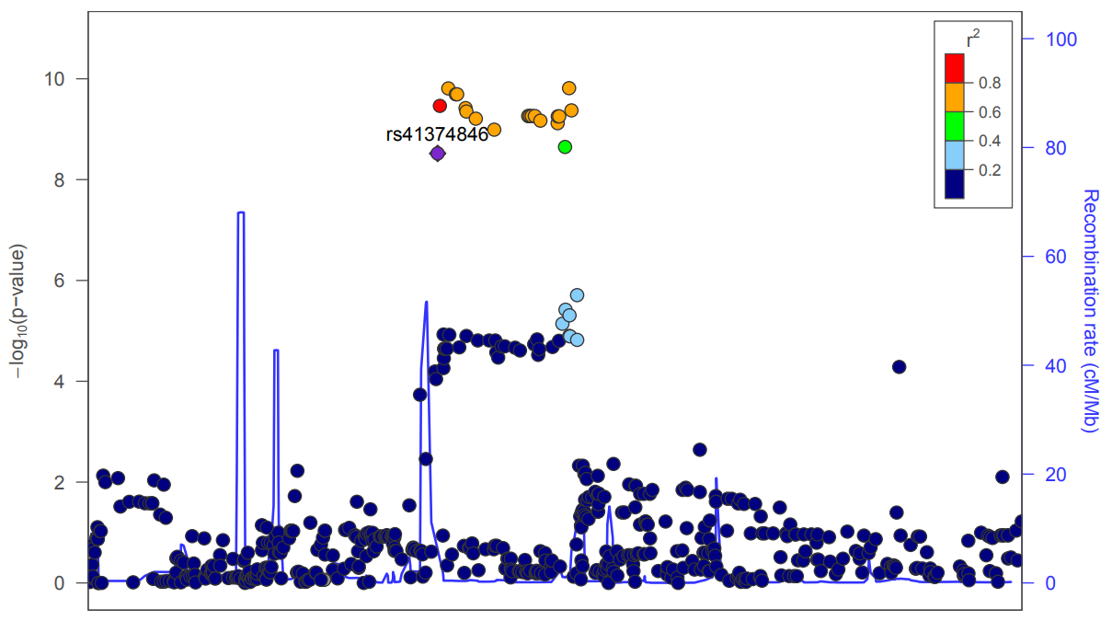
a)
Chromosome 15
b)
Position on chr15 (Mb)
Genotyped + Imputed SNPs
c)
Genotyped + Imputed SNPs

Slide 3
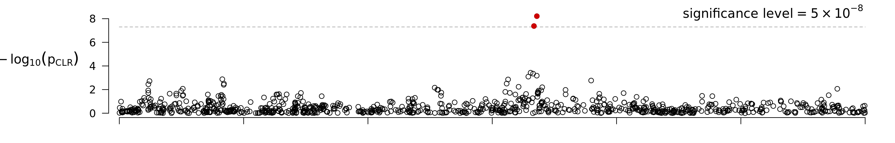
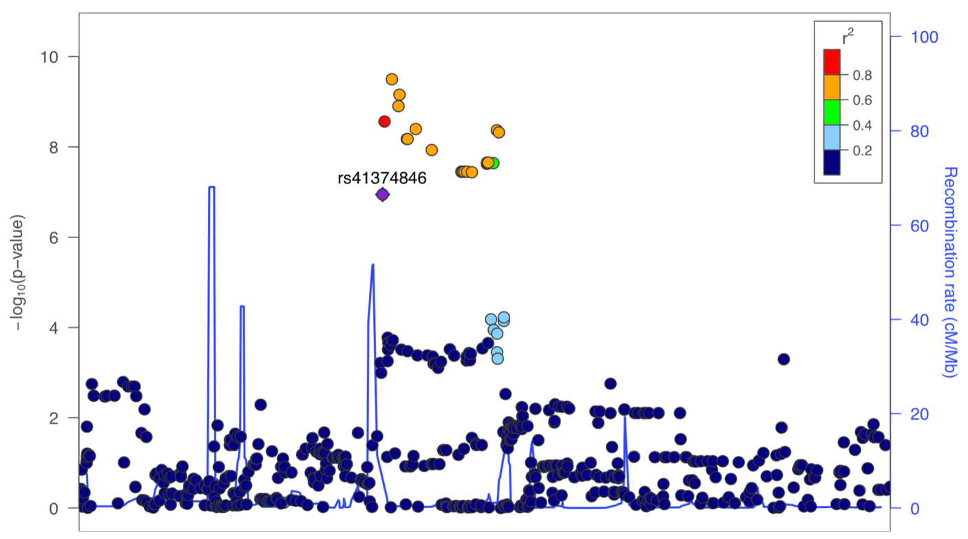
a)
Chromosome 15
b)
With 10 PCs as covariates
Position on chr15 (Mb)
Genotyped + Imputed SNPs
c)
Genotyped + Imputed SNPs

Slide 4
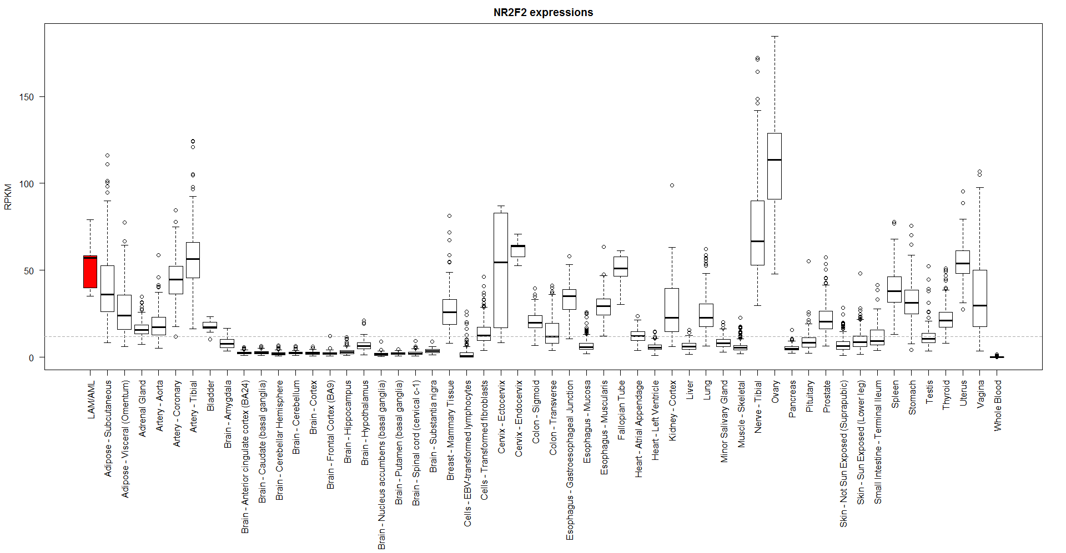
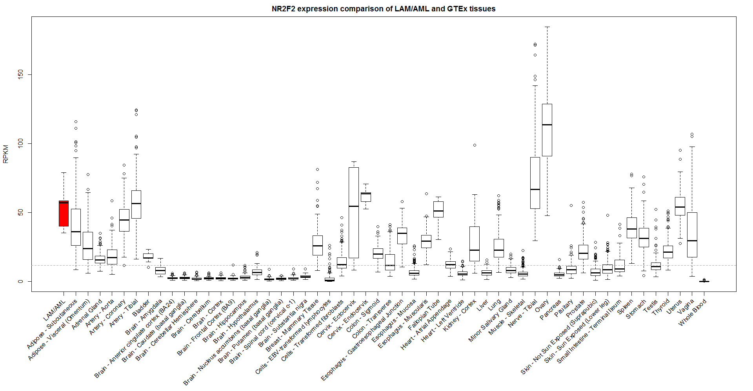
a)
b)

